Slide 1
Impact Assessment of Password Reset MitM attack with Two-factor Authentication
Kota Sasa, Hiroaki Kikuchi
Meiji University
Notes:
Thank you chair person.
I am going to talk about a new attack called password reset man in the middle attack and its impact.

Slide 2
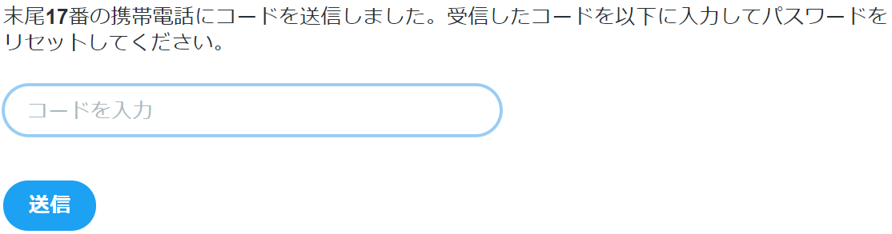
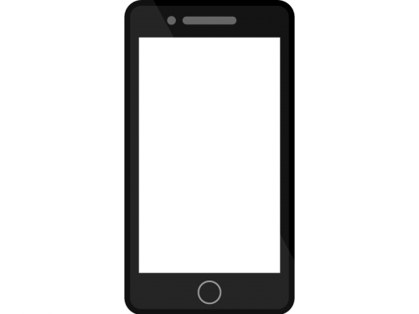
Background：Password Reset with Two-factor Authentication
Please enter your received code
code
Your *** password reset code is 259003. You can’t reply this message.
send
Notes:
Let me begin with the background of our study.
Two factor authentication is widely used, to send a conﬁrmation message via SMS, like this. Two factor authentication is more secure than a simple password authentication because it prevents intrusion even if your password was compromised.

Slide 3
However, we have two SMSs
User Registration
Password Reset
Sign up
Password
reset
Name
A
Password
**
Tell
Tell
080 - 11 - 22
080 - 11 - 22
Notes:
However, we have two SMSs. Green is an authentication when registering an account. Orange is the other authentication when resetting password. These are similar.

Slide 4


Password Reset Man-in-the-Middle Attack (PRMitM) [Gelernter, IEEE Symposium on Security and Privacy 2017]
Sign up
Password
reset
A
Victim
B
Attacker
C
Target website
Resister at B
Name
A
Password
HTTP
Tell
Victim A has an account
**
Tell
HTTP
From B
User A
080 - 11 - 22
080 - 11 - 22
From A
Short Message Service (SMS)
Veriﬁcation code is 1234.
User A
Sign up B
Take over A
Enter code
HTTP
1234
Notes:
Hence, in 2017, Gelernter proposed the Password Reset Min-in-the middle attack, which can take over a user’s account by using Two Factor Authentication via SMS.
We have three parties, victim A, attacker B and target website C.
Victim A attempts to register to site B created by the attacker.
But actually, the attacker requests a password reset to the target site C using the phone number of user A on behave of him.
Site C thinks that A is requesting a password reset and sends back to him a verification code for his account. He thinks that code was sent by B. He enters the reset code in the attacker site B. Then, B can change the password and takes over his account.
Two factor authentication was believed to improve security, however, it makes the site more vulnerable than before.

Slide 5
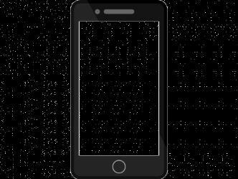
Gelernter et al.’s Suggestions
1. Use an URL for password reset instead of SMS reset code.
2. Specify the service name in the SMS message.
3. Warn password reset in the SMS message.
Sign up B
Please reset under site
https://aaaa/bbbb
Enter code
https://aaaa/bbbb
Your verification code is 259003. You can’t reply this message. S! JAPAN
Your S! JAPAN password reset code is 259003. You can’t reply this message.
Notes:
Gelernter et al. suggested three countermeasures against PRMitM attack.
1. Using a URL for password reset instead of an SMS reset code. Victim user could appear suspicious and would be less likely to invoke the PRMitM attack.
2. Specify the service name in the SMS message.
Victim easily finds it was sent from "S! Japan" rather than site B.
3. Warning password reset in the SMS message.
With warning message like "password reset code", users can notice that being attacked.

Slide 6
Gelernter et al.’s Suggestions
1. Use an URL for password reset instead of SMS reset code.
Cannot be judged for genuine or faked.
New phishing target.
2. Specify the service name in the SMS message.
3. Warn password reset in SMS message.
→No one read the warning message carefully.
Notes:
However, Gelernter et al's suggestion has several issues.
1. If a short URLs is used here, it cannot be judged for genuine or faked.
URL links can be a new phishing target.
As for 2nd and 3rd suggestions, actually no one read the warning message carefully.
Even if services name was specified, they don't care it at all and could be compromised.
Moreover, we found out new two more threads.

Slide 7
New Threads
Long SMS attacks
Numeric authentication code attacks
1
Alphanumeric authentication code
Please enter identification code to register an account. This process make this registration secure. The authentication code is 368552. After entering this code, please enter second code to send. Repeat twice makes it possible to register more secure.
Your S! JAPAN password reset code is b2g6yk4h. You can’t reply this message.
Numeric authentication code
2
Your S! JAPAN password reset code is 259003. You can’t reply this message.
Your S! JAPAN password reset code is 259003. You can’t reply this message.
Notes:
The first attack is a long SMS attack.
This is an attack that forces a victim not to read SMS message.
Attacker sends a very long message for the first time and makes the victim to enter the first code.
Given second message, a user might carelessly read a second message and type a code because the second procedure seems to be the same as the ﬁrst.
The second attack is a numeric authentication code attack.
Here are two SMS messages; one with alphanumeric code and the other is numeric codes.
You can find the numeric code looks as emphasized, and regarded as a link.
Since it is too explicit to read the remaining message, the victim is attacked.

Slide 8
Research Questions
Are the Japanese major websites secure against the PRMitM attack?
What styles of message does work effective to reduce risk of the PRMitM attack?
Who are vulnerable to the PRMitM attack?
Notes:
Here we have some research questions of our study.
1. Are the Japanese major websites secure against the PRMitM attack?
2. What styles of message does work effective to reduce risk of the PRMitM attack?
3. Who are vulnerable to the PRMitM attack?

Slide 9
Our Approach
Investigate the top 200 websites of Alexa Japan
Account registration available?
Password reset via SMS used?
A warning given if a password reset.
Perform user study on individual characteristics vulnerable to the PRMitM attacks
Notes:
Here is Our Approach.
1. Investigate the top 200 websites of Alexa Japan.
We tested websites by using the three-item check sheet.
Is account registration available?
Is password reset via SMS used?
Is a warning given if the SMS speciﬁes a password reset.
2. Perform user study on individual characteristics with who are likely to be vulnerable to the PRMitM attack. For example, security knowledgeable people would reduce the risk of PRMitM? How about careful people are?

Slide 10
Investigation Result Example
We found several services by using two factor authentication via SMS. For example,
Twitter has secure message which is warning.
Yahoo JAPAN has unsecure message which is vulnerable to PRMitM attack.
Name | Password reset SMS message
Twitter | Your Twitter password reset code is160973.
Yahoo JAPAN | Veriﬁcation code：375403 Please enter the code. Yahoo! JAPAN
Notes:
By investigation, we found several services by using two factor authentication via SMS. For example, Twitter and Yahoo JAPAN. Twitter has secure message which is warning.
On the other hand, Yahoo JAPAN has unsecure message which is vulnerable to PRMitM attack.

Slide 11
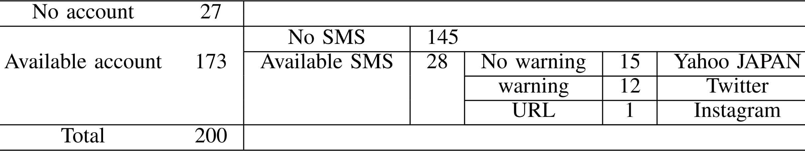
Investigation Result
＊There were no websites that omitted the service name.
Name | Alexa rank | Password reset SMS message
Google | 1 | G-910957 is your Google veriﬁcation code.
Yahoo JAPAN | 4 | Veriﬁcation code：375403 Please enter the code. Yahoo! JAPAN
Amazon | 5 | Your Amazon veriﬁcation code is160973.
LinkedIn | 63 | LinkedIn veriﬁcation code is「123512」
Notes:
Here we show our Investigation result on the major Japanese website.
We found 173 websites that have user accounts out of 200.
Among them, there are 28 websites with password reset via SMS, including
15 websites that have no warning such as Yahoo Japan.
These sites are vulnerable under the PRMitM attack.
The 15 websites contain the duplicated services at different domains, and four unique sites are shown here: Google, Yahoo, Amazon and Linkedin.

Slide 12
Experiment Method Outline
In order to investigate the characteristics of users receiving PRMitM attack, we conducted an experiment with 184 subjects collected from crowdsourcing service ``CroudWorks’’
Notes:
Now we turn to the user study experiment.
In order to investigate the characteristics of users receiving PRMitM attack, we conducted an experiment with 184 subjects collected from crowdsourcing service "Cloud Works".

Slide 13




Four Toy Sites and Subject Groups
 | 1 | 2 | 3 | 4
Name | S! JAPAN | Cowtter | Majebook | Mstagram
Operation | N/A | Cowtter veriﬁcation code | S! JAPAN Reset code | Mstagram veriﬁcation code
Purpose | Registration practice | SMS practice | Malicious (PRMitM Attack) | Survey of the impact of SSL
type | Warning | Numeric | Alphanumeric | Long | Subjects
0 | √ | × | √ | √ | 37
1 | × | × | √ | √ | 38
2 | × | √ | × | √ | 40
3 | × | × | √ | × | 35
4 | × | √ | × | × | 34
Notes:
We show the four toy sites.
All subjects register on the websites from (1) to (4).
The first and the second sites are used for practice.
The fourth website tests TLS or not.
But, the third website, pseudo Facebook, is malicious. At the third website, we set up the PRMitM attack to reset the victim’s password of the first website.
If a careless subject enters the code here, he is regarded as vulnerable.
A set of subjects was divided into ﬁve groups and SMS messages were sent according to this table. Warning style is of resetting password.
Numeric and alphanumeric are style of reset codes.
The Long style means sending two SMS messages. One is fake long and the other is short one with target code.
After all, subjects are required to complete questionnaire on user profile and security knowledge.

Slide 14
Security Behavior Intentions Scale (SeBIS) [Serge Egelman, SIGCHI Conference on Human Factors in Computing Systems (CHI’ 15)]
Question to survey to measure security knowledge and behavior
18 questions (two questions are judge whether users answered properly)
The answer in 5 score, the higher the score, the higher the security knowledge
5 | I change my passwords frequently.
7 | I use different passwords for different accounts that I have.
8 | When I create a new online account, I try to use a password that goes beyond the site’s minimum requirements.
Notes:
Here is questionnaire called SeBIS, which examine subject's security knowledge and behavior.
SeBIS consists of 18 questions to be answered in 5 score.
For example, question no. 5, I change my passwords frequently.
The higher the score, the higher the security knowledge he has.

Slide 15
Experimental Result 1
type | SMS style | Enter | Cancel | Successful Attack ratio[%]
0 | No warning | 35 | 2 | 94.6
1 | Short Numeric | 30 | 8 | 78.9
2 | Short Alphanumeric | 28 | 12 | 70.0
3 | Long Numeric | 28 | 7 | 80.0
4 | Long Alphanumeric | 22 | 12 | 64.7
Notes:
Here we show Experimental results in the table.
The table shows the number of subjects for five SMS styles who enter the reset code at third malicious toy site, that is, vulnerable subjects.
Successful attack ratio is a fraction of vulnerable subjects for each group.
It means how insecure the SMS style is.
We see that the case of a no warning message has the highest attack ratio of 94.6%.
That makes sense.
In comparison between numeric and alphanumeric codes, we need compare type 1 plus 3 and that of 2 plus 4. In order to clarify the attack ratio of each style of SMS message, we perform a chi-square test.

Slide 16
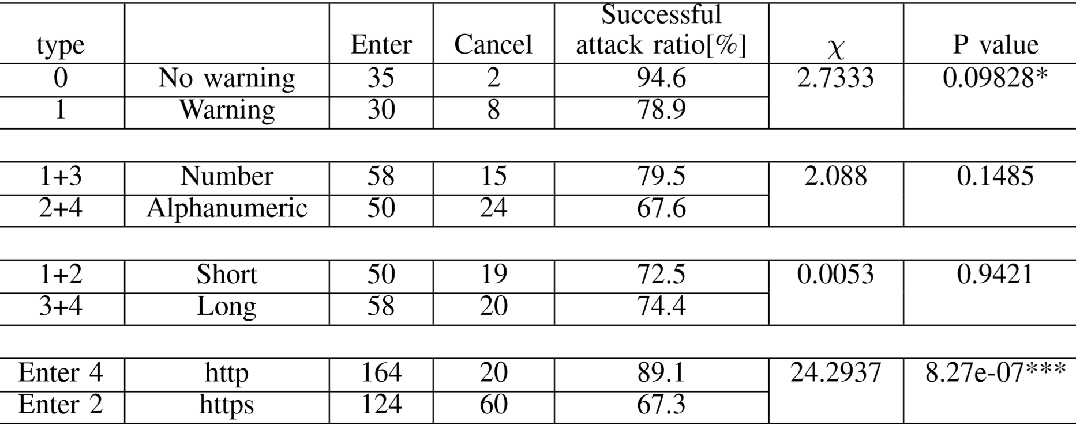
Evaluation 1. Chi-square test
0.09828*
Enter 2
HTTPS
Enter 4
HTTP
Notes:
How much significant the difference is?
At the second table, the attack ratio with alphanumeric reset code is 67%, about 13% lower than that of numeric code, but the difference is not significant.
You see that the attack ratio with no warning is 94%, which is higher than that with warning.
We show the chi-square test that the difference is significant with significant level of 90%.

Slide 17
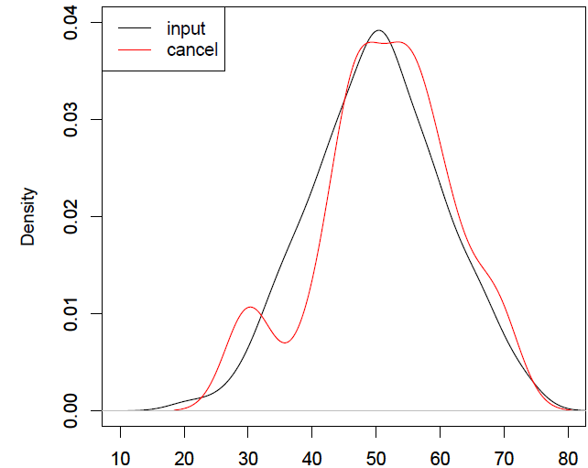
Result 2 : SeBIS Score Distribution
Vulnerable
Score | Enter | Cancel | Successful Attack ratio[%]
Over 50 | 66 | 21 | 75.9
Under 50 | 54 | 18 | 75.0
Safe
SeBIS score
Notes:
We show the distribution of SeBIS scores for all subjects.
Red is safe subject and black is vulnerable.
You see that both are distributed closely. Hence, there is not significant difference between them. This means secure knowledgeable people were vulnerable.

Slide 18
Result 3 : Successful Attack Ratios By User Attributes
Attack ratios are distributed almost at 75 for any demographic group
 |  | Enter | Cancel | Total | Successful attack ratio[%]
Age | Under 20 years old | 2 | 1 | 3 | 67
 | 20’s | 48 | 16 | 64 | 75
 | 30’s | 50 | 14 | 64 | 78
 | 40’s | 27 | 10 | 37 | 73
 | 50 years and over | 16 | 0 | 16 | 100
Did you register phone number in Twitter? | Yes | 27 | 7 | 34 | 79
 | No | 95 | 31 | 126 | 75
 | Forget | 21 | 3 | 24 | 88
Did you register phone number in Facebook? | Yes | 41 | 12 | 53 | 77
 | No | 85 | 29 | 114 | 75
 | Forget | 17 | 0 | 17 | 100
Did you register phone number in Yahoo Japan? | Yes | 39 | 7 | 46 | 85
 | No | 74 | 28 | 102 | 73
 | Forget | 30 | 6 | 36 | 83
except the subjects aged 50 years or older have 100% vulnerable.
Attack ratio depends on the properties such as whether phone number is registered or not.
Subjects who did not remember whether or not they registered phone numbers on Twitter, Facebook, and yahoo were more vulnerable to attacks than any others.
Notes:
Here is a demographic successful attack ratio.
Attack ratios are distributed almost at 75 for any demographic group except the subjects aged 50 years or older have 100% vulnerable.
On the other hand, we find that subjects who did not remember whether or not they registered phone numbers on Twitter, Facebook, and yahoo were more vulnerable to attacks than any others.

Slide 19
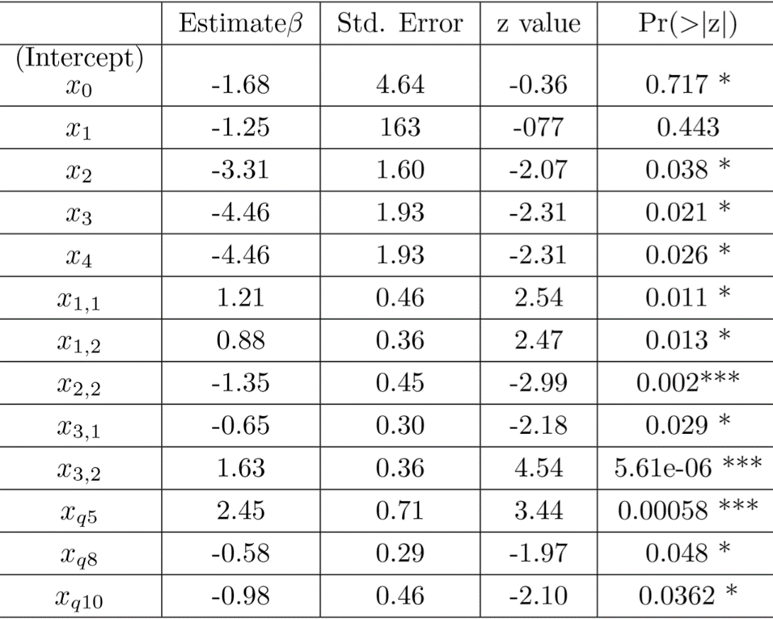
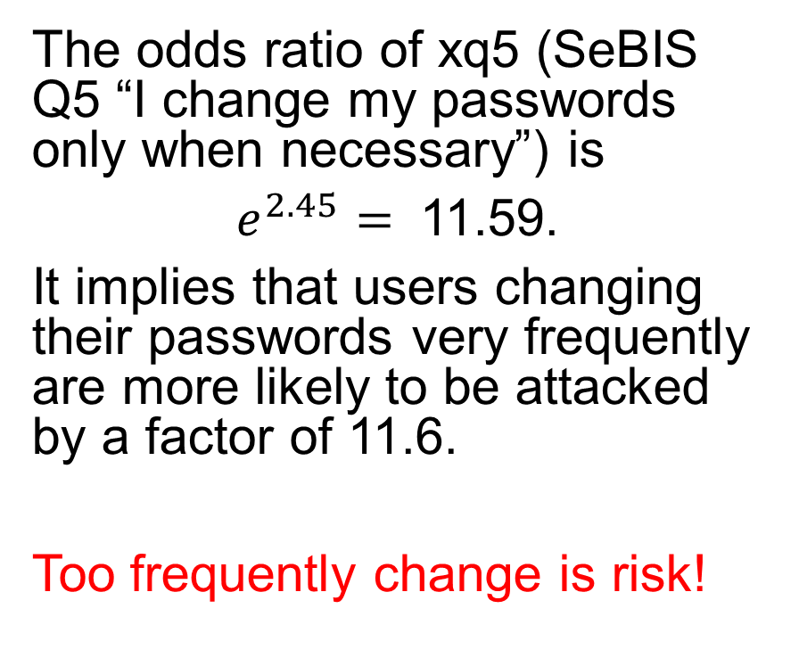
Evaluation 2. logistic regression analysis
The odds ratio of xq5 (SeBIS Q5 “I change my passwords only when necessary”) is
$e^{2.45}=$ 11.59.
It implies that users changing their passwords very frequently are more likely to be attacked by a factor of 11.6.
Too frequently change is risk!
Notes:
Who are more vulnerable to the attack?
To answer the question, we performed a logistic regression analysis for the successful attack ratio as the objective variable and personal properties of subjects as explanatory variables.
This shows the result of logistic regression.
We found very interesting results from the table here.
The odds ratio of xq5 is very high as
𝑒 to 2.45 is 11.59.
xq5 is SeBIS Q5 “I change my passwords only when necessary”.
It implies that users changing their passwords very frequently are more likely to be attacked by a factor of 11.6.

Slide 20
Conclusions
We showed that there are 4 web services that are not taking countermeasures against PRMitM attack on Japanese access top 200 site.
According to the experimental result of 180 subjects, we have showed that
Sending warning message resetting password is effective for reducing risk of the PRMitM attack.
Vulnerable users do not remember whether they have registered accounts or not.
Users who frequently change their passwords are 11.6 times more vulnerable to users who do not change much.
Notes:
Let me conclude my talk.
We have shown that there are 4 web services that are not taking countermeasures against PRMitM attack on Japanese access top 200 site.
According to the experimental result of 180 subjects, we have showed that
1. Sending warning message resetting password is effective for reducing risk of the PRMitM attack.
2. Vulnerable users do not remember whether they have registered accounts or not.
3. Users who frequently change their passwords are 11.6 times more vulnerable to users who do not change much.
Thank you.

Slide 21

SMS types (x1, x2, x3)
usability (x1,1, x2,1, x3,1)
security (x1,2, x2,2, x3,2)
xq8
When I create a new online account, I try to use a password that goes beyond the site’s minimum requirements.
xq10
When someone sends me a link, I don’t open it without ﬁrst verifying where it goes.

Slide 22
Impact Evaluation of PRMitM Attacks
Register | Enter | Cancel | Total | ratio
Yes | 39 | 7 | 46 | 0.25
No | 74 | 28 | 102 | 0.55
Forget | 30 | 6 | 36 | 0.20
If Yahoo! Japan adopt warning message, they can reduce the number of victims to 1.45 million.
Damage estimation that Yahoo may possibly receive
The number of Yahoo account active users are 36.14 million (September 2016)
36.14×0.256 = 9.25184
We assume that the number of users who have registered telephone numbers in Yahoo is about 9.25 million
No warning
9.25 * 35/37 = 8.75
8.75 million people are vulnerable
Warning
9.25 * 30/38 = 7.30
Reduce vulnerable people to 7.3 million
type | Warning | Enter | Cancel | Successful Attack ratio[%]
0 | No | 35 | 2 | 94.6
1 | Yes | 30 | 8 | 78.9
Notes:
According the results of this study, we estimate how many users are potentially vulnerable in the Yahoo Japan as an example of actual companies.
Our estimate shows that 9.25 million users are subject to be attacked by the PRMitM attack.
Yahoo Japan does not send warning message when user attempts to reset password.
Hence, we estimate more than 8.75 million victims there.

Slide 23
Impact Evaluation of PRMitM Attacks
Register | Enter | Cancel | Total | ratio
Yes | 39 | 7 | 46 | 0.25
No | 74 | 28 | 102 | 0.55
Forget | 30 | 6 | 36 | 0.20
If Yahoo! Japan adopt warning message, they can reduce the number of victims to 1.45 million.
Damage estimation that Yahoo may possibly receive
The number of Yahoo account active users are 36.14 million (September 2016)
36.14×0.256 = 9.25184
We assume that the number of users who have registered telephone numbers in Yahoo is about 9.25 million
No warning
9.25 * 35/37 = 8.75
8.75 million people are vulnerable
Warning
9.25 * 30/38 = 7.30
Reduce vulnerable people to 7.3 million
type | Warning | Enter | Cancel | Successful Attack ratio[%]
0 | No | 35 | 2 | 94.6
1 | Yes | 30 | 8 | 78.9
Notes:
If they adopt warning message, they can reduce the number of victims to 1.45 million.

Slide 24
Password Reset Man-in-the-Middle Attack (PRMitM) [Gelernter, IEEE Symposium on Security and Privacy 2017]
Sign up
Password
reset
A
Victim
B
Attacker
C
Target website
Resister at B
Name
A
Password
HTTP
Tell
Victim A has an account
**
Tell
HTTP
From B
User A
080 - 11 - 22
080 - 11 - 22
From A
Short Message Service (SMS)
Veriﬁcation code is 1234.
User A
Sign up B
Take over A
Enter code
HTTP
1234
Notes:
However, in 2017, Gelernter proposed the Password Reset Min-in-the middle attack, which can take over a user’s account by using Two Factor Authentication via SMS.
We have three parties, victim A, attacker B and target site C.
Victim A attempts to register to site B created by the attacker.
Site B prompts user A to enter the phone number as a procedure for registration.
However, the attacker sends a password reset request to the target site C with his telephone number on behave of him.
Site C thinks that A is requesting a password reset and sends back to him a verification code for his account. He thinks that the code was sent by site B, and he enters the code in the attacker site B. Then B can change his password and finally takes over his account.
Two factor authentication was believed to improve security, however, it makes the site more vulnerable than before.

